Slide 1
Flow Rate Measurement Using Venturi Tube
Based on ISO 5167-4:2003 (E)

Slide 2
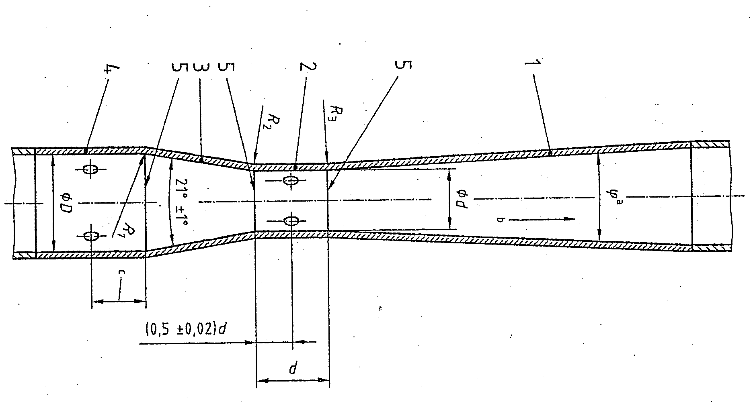
1. Configuration of a Classical Venturi Tube
A
B
C
E
Conical convergent
Cylindrical throat
Conical convergent
Entrance cylinder
Connecting planes
a 7º ≤ ϕ ≤ 15º
b Flow direction
c = 0.5D ± 0.05D
At least 4 pressure tapings shall be provided for the upstream and throat pressure measurements.

Slide 3
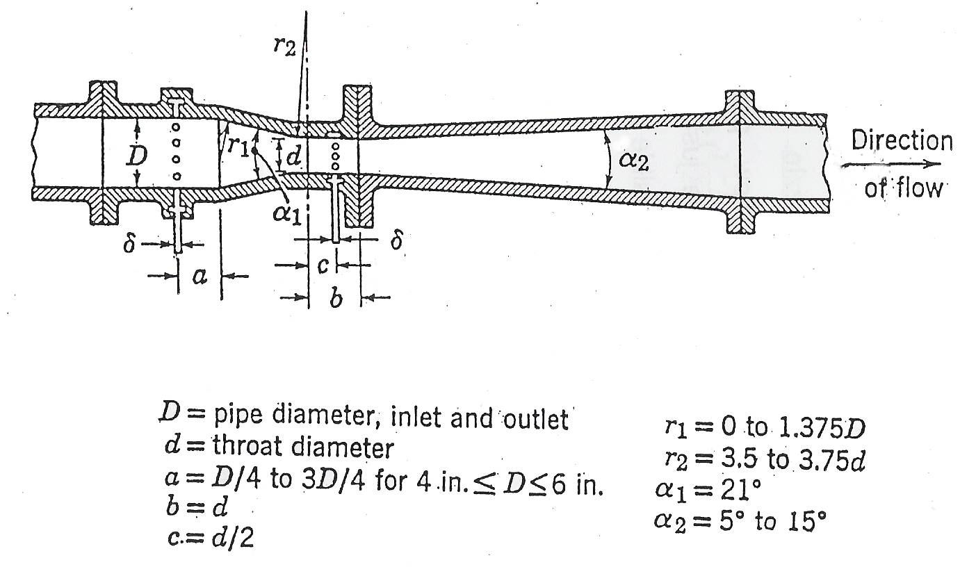
For comparison: Herschel-type Venturi Tube (USA)

Slide 4
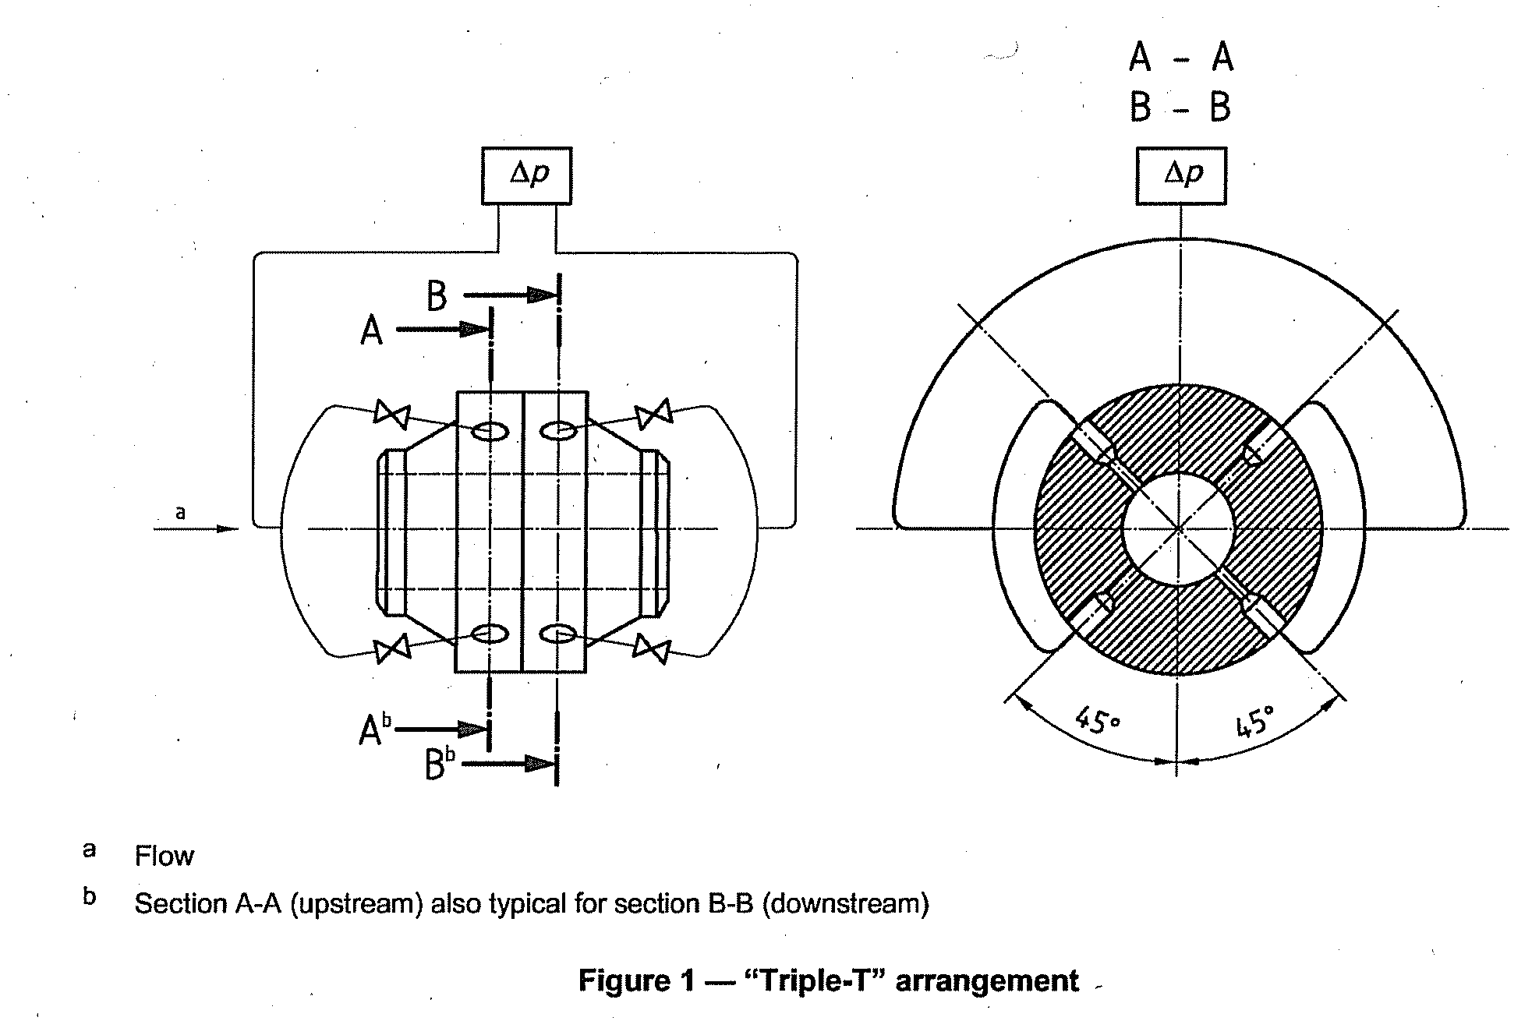
Installation:
“Triple-T” arrangement for multiple pressure tapes
“T” connector
#3
#1
#2

Slide 5
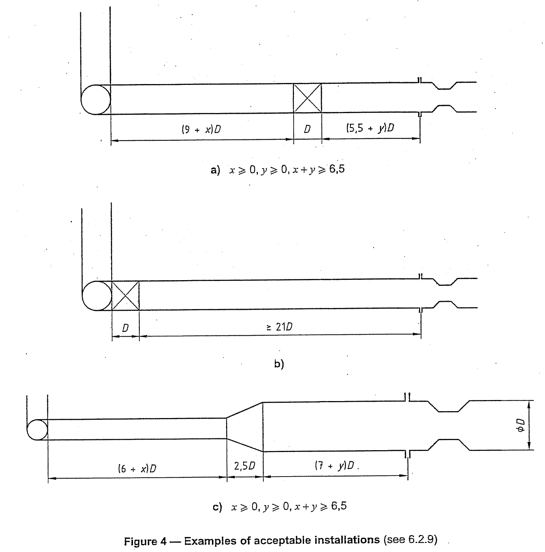
Installation:
Piping

Slide 6
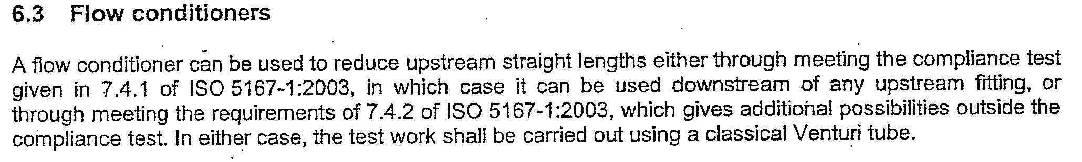
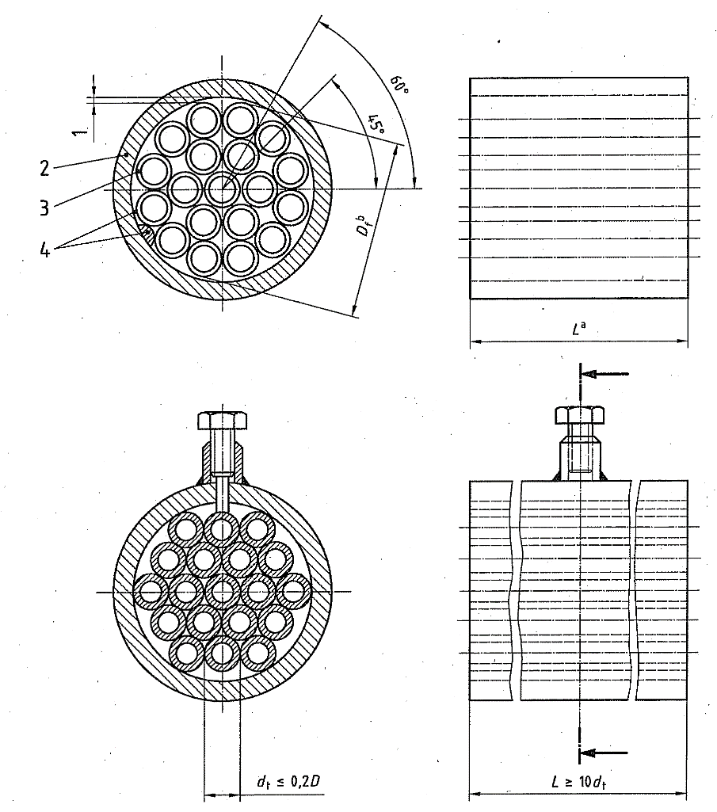
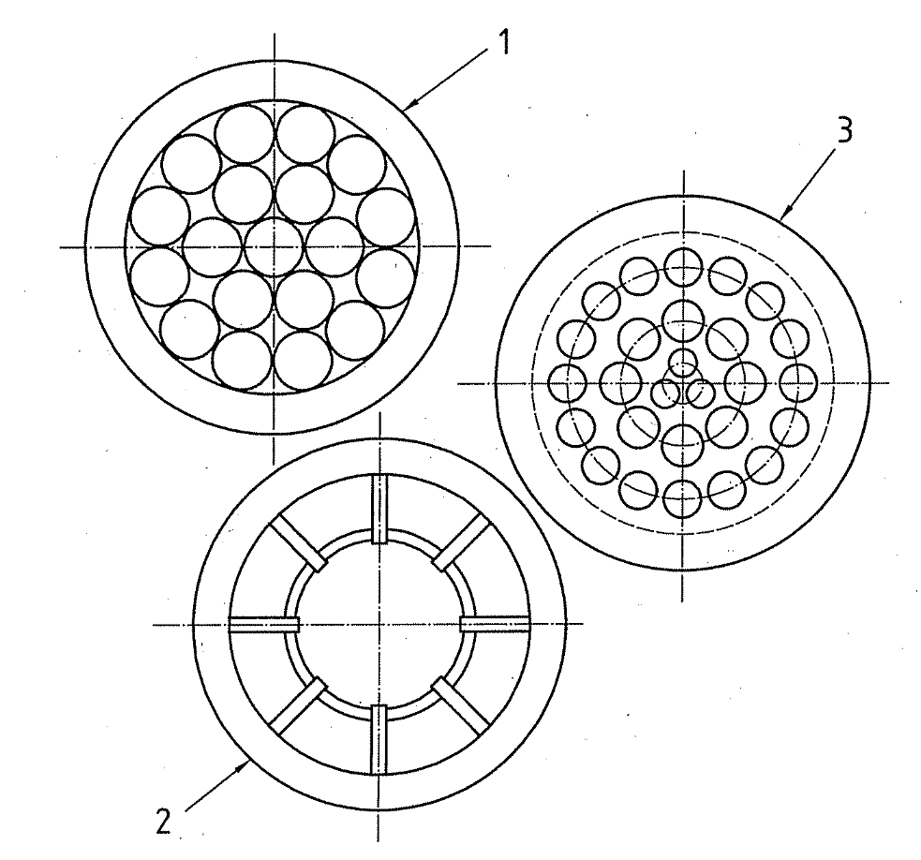
Installation:
Flow Conditioners & Straighteners

Slide 7
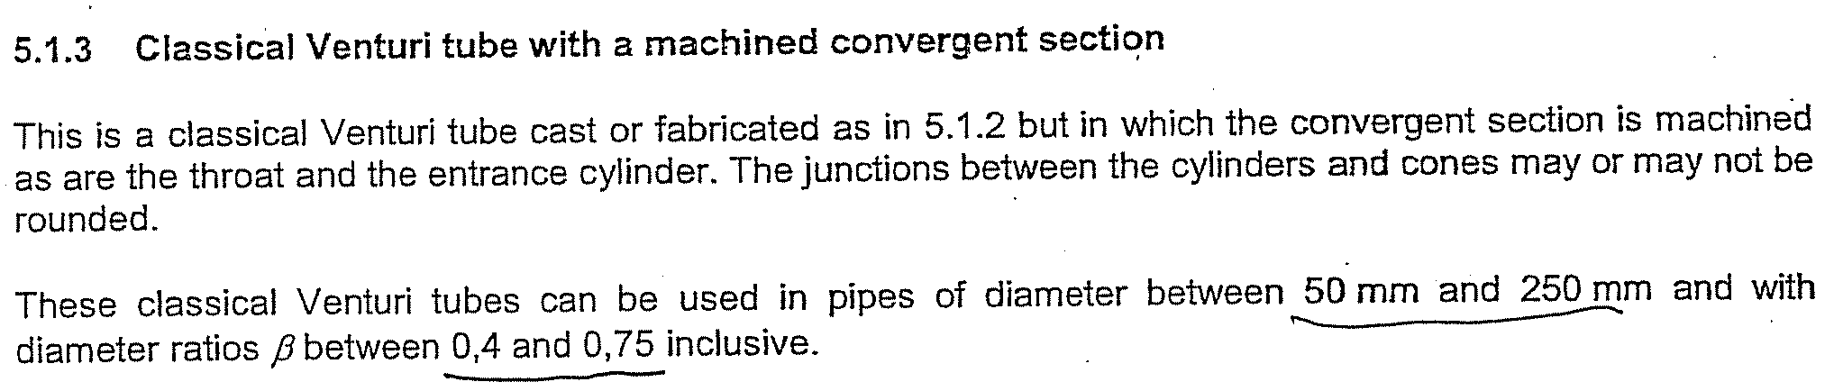
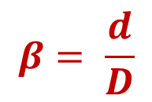
Machined convergent section
Classical Venturi tube with a Machined Convergent Section
    50 mm ≤ D ≤ 250 mm
    β = 0.4 ~ 0.75

Slide 8
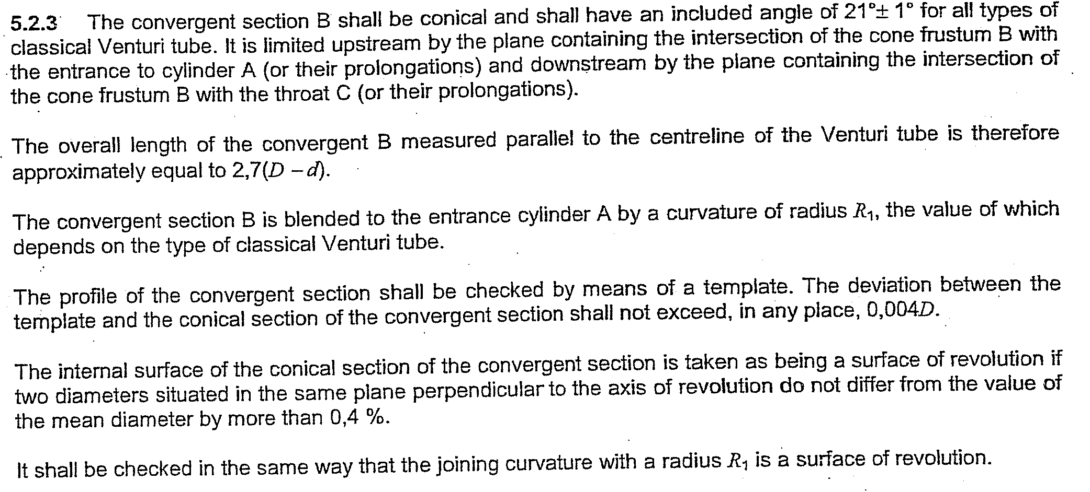

Slide 9
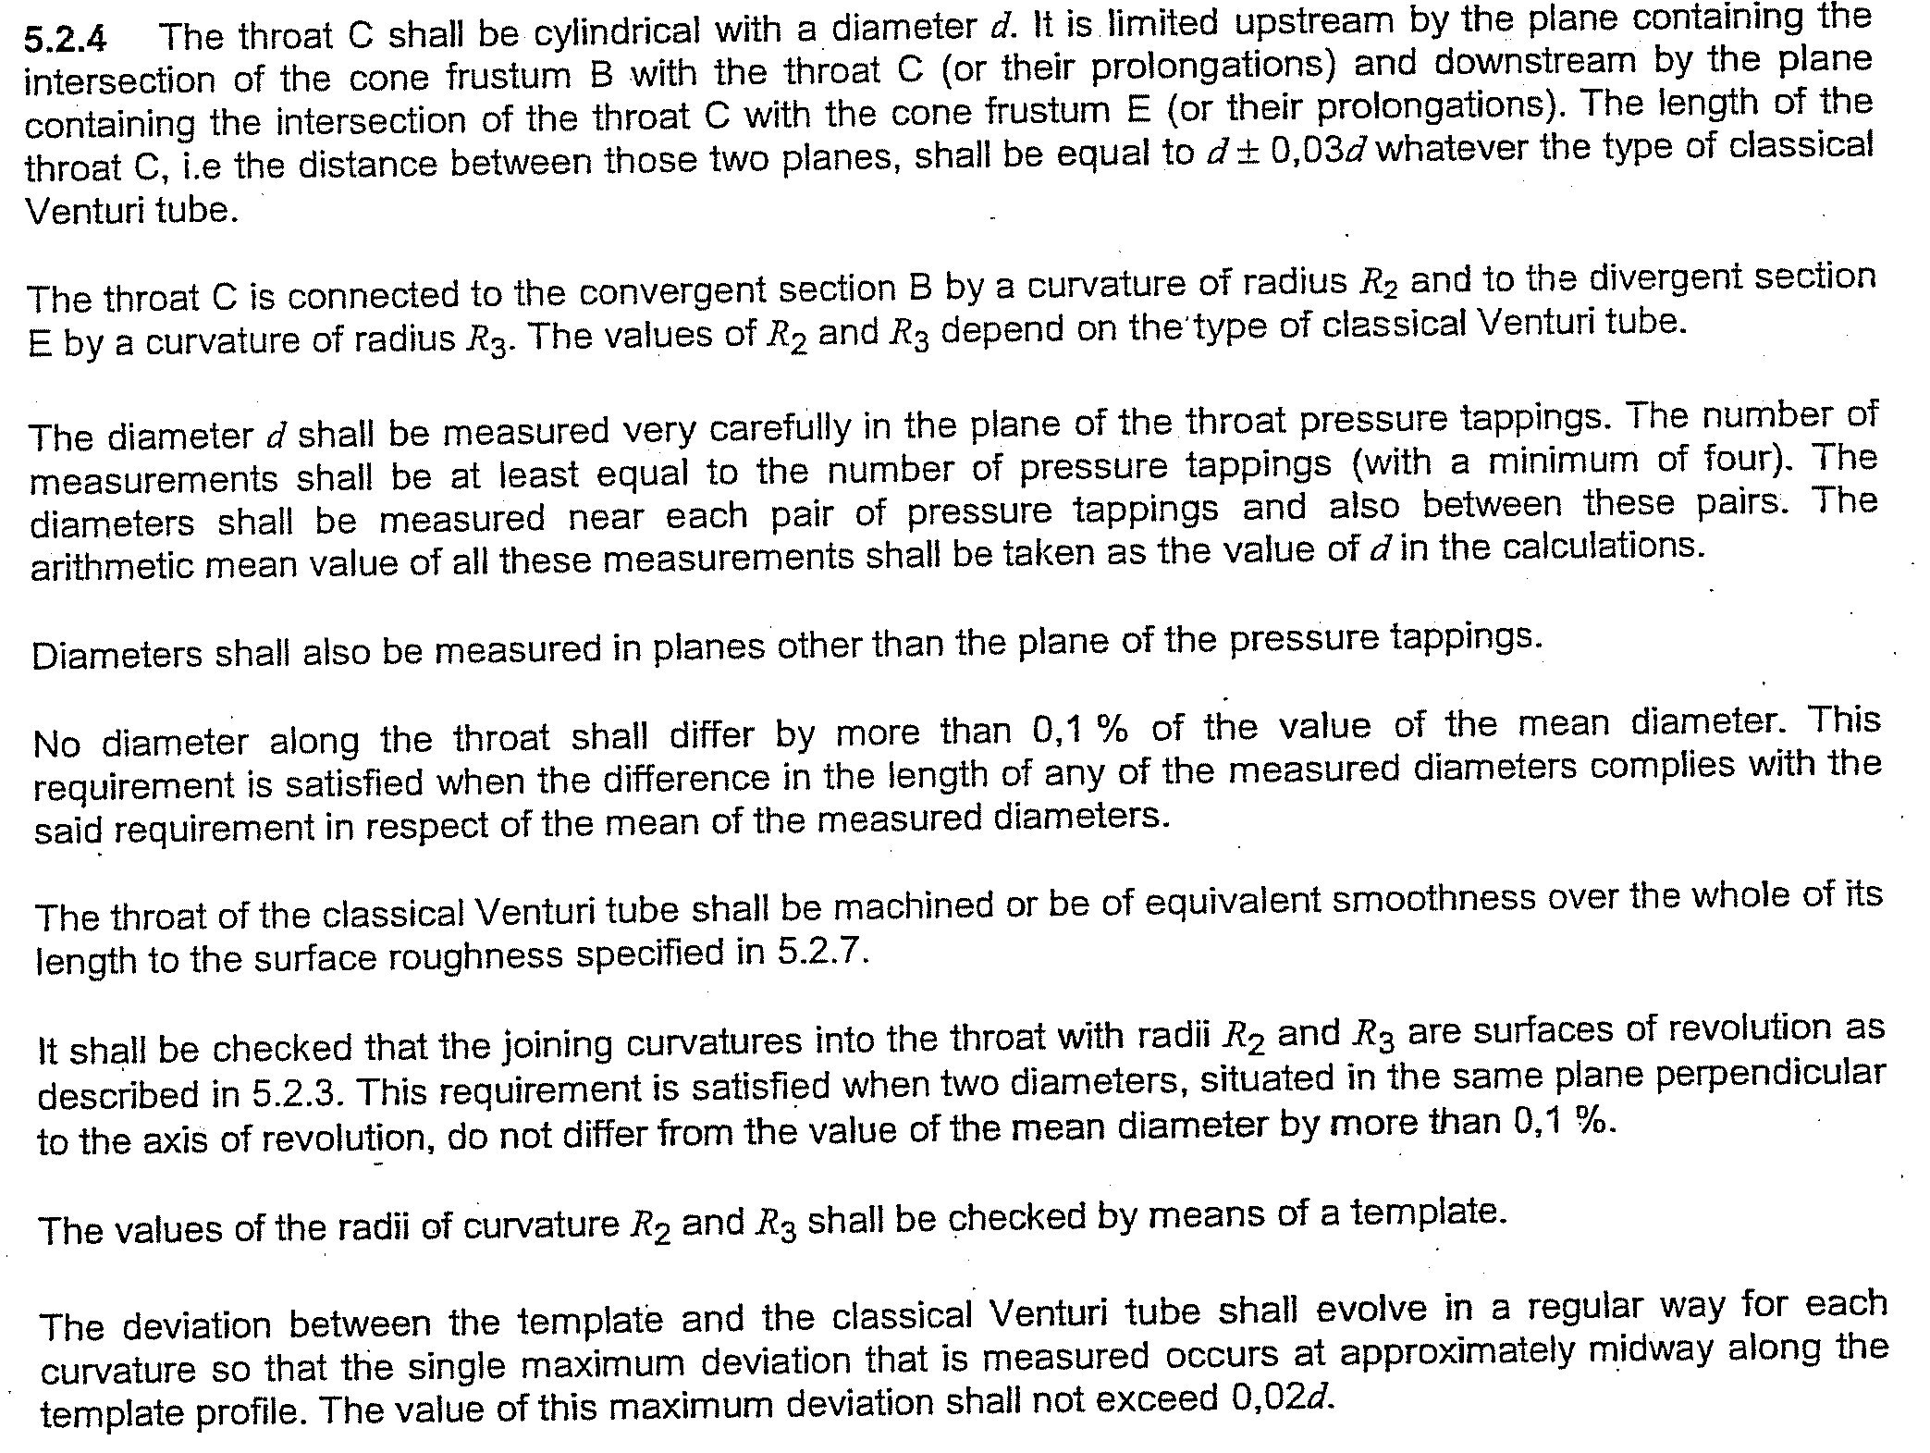

Slide 10
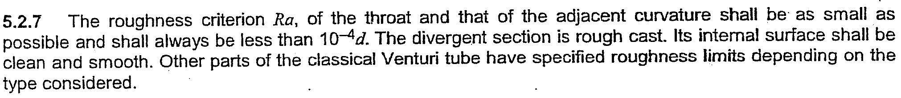
Roughness Ra < 10⁻⁴ d

Slide 11
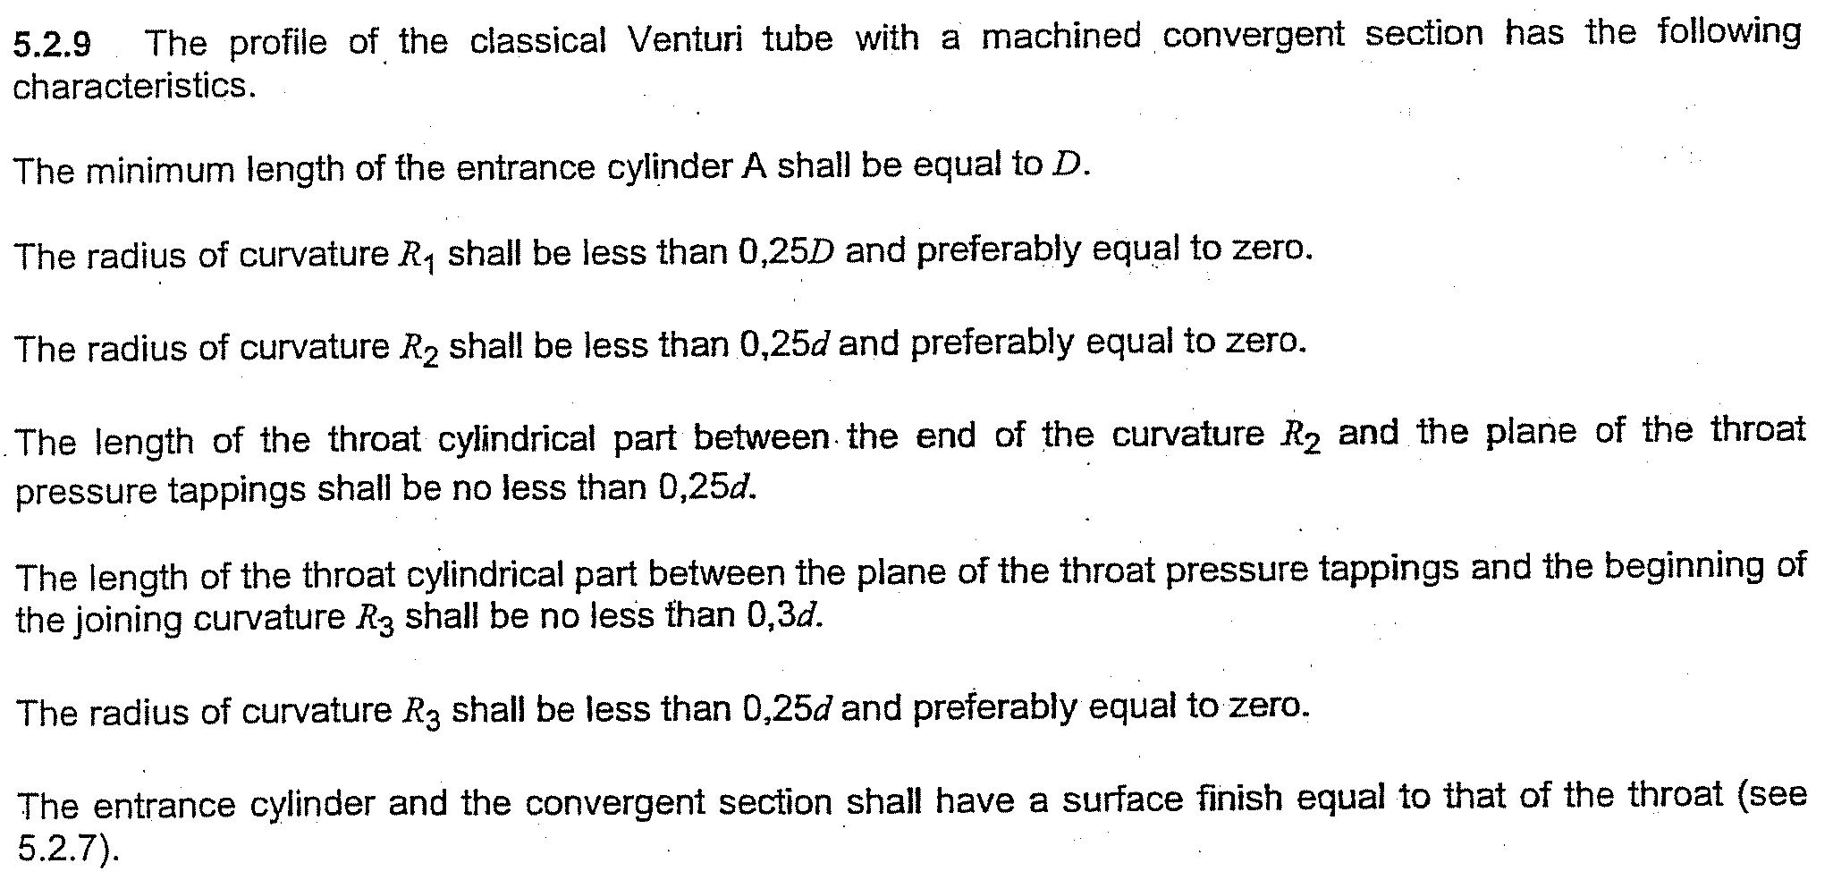

Slide 12
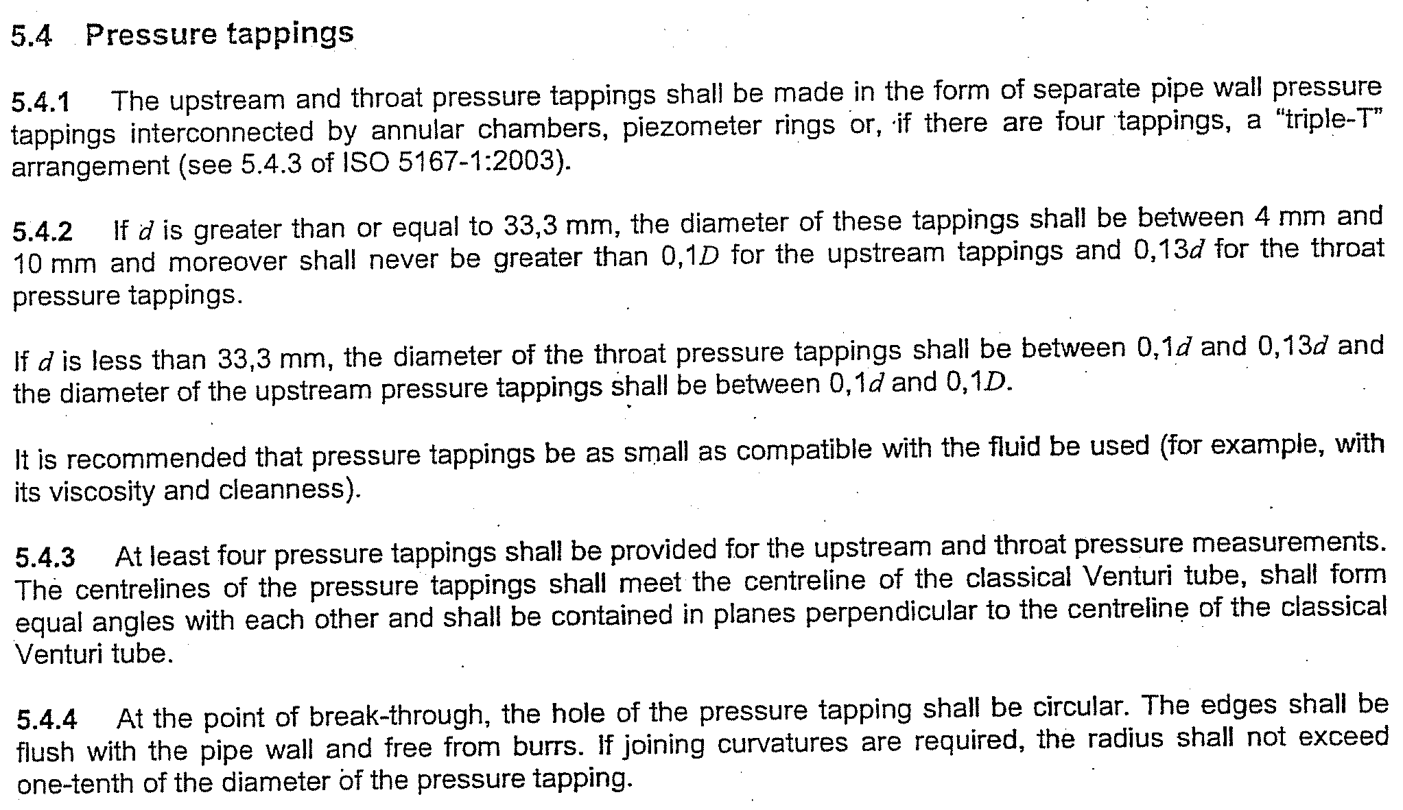

Slide 13
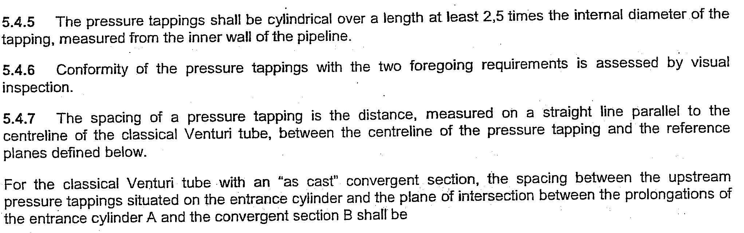

Slide 14
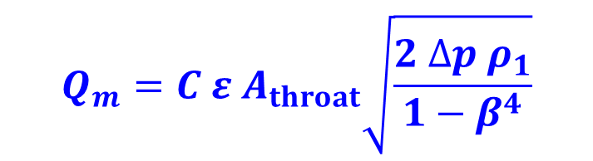




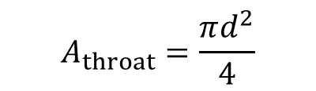

2. Principles
: mass flowrate
: discharge coefficient
: expansibility factor (expansion factor)
: fluid density at the temperature and pressure
for which the volume is stated

Slide 15
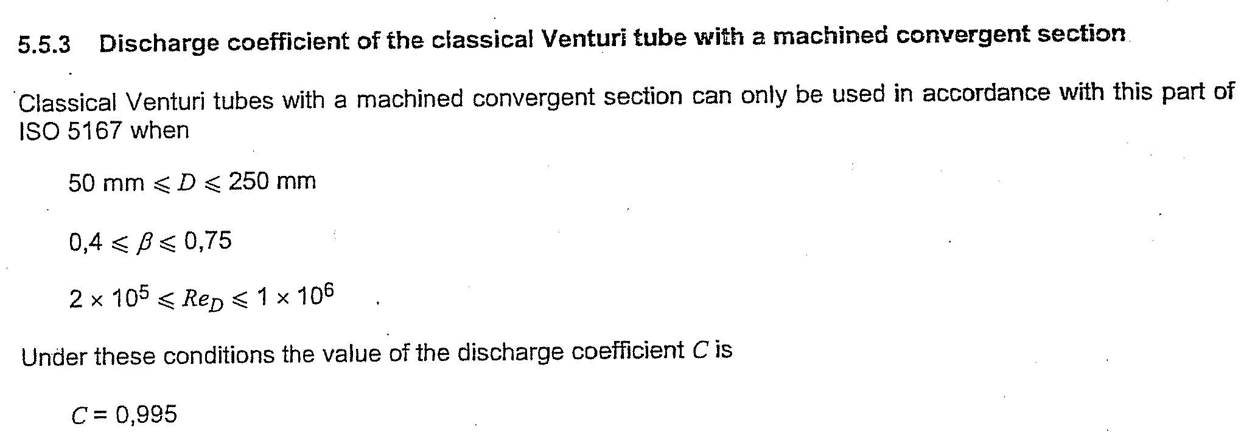
Discharge coefficient, C

Slide 16
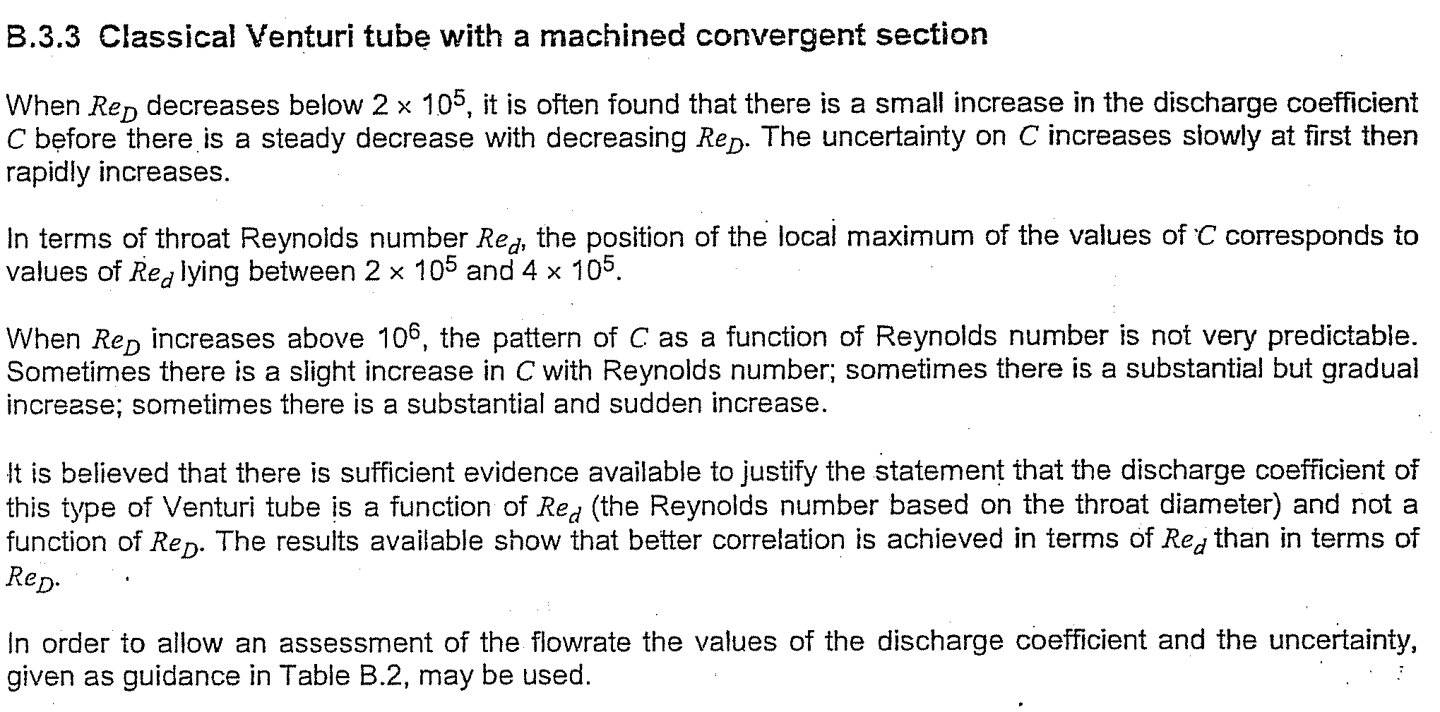

Slide 17
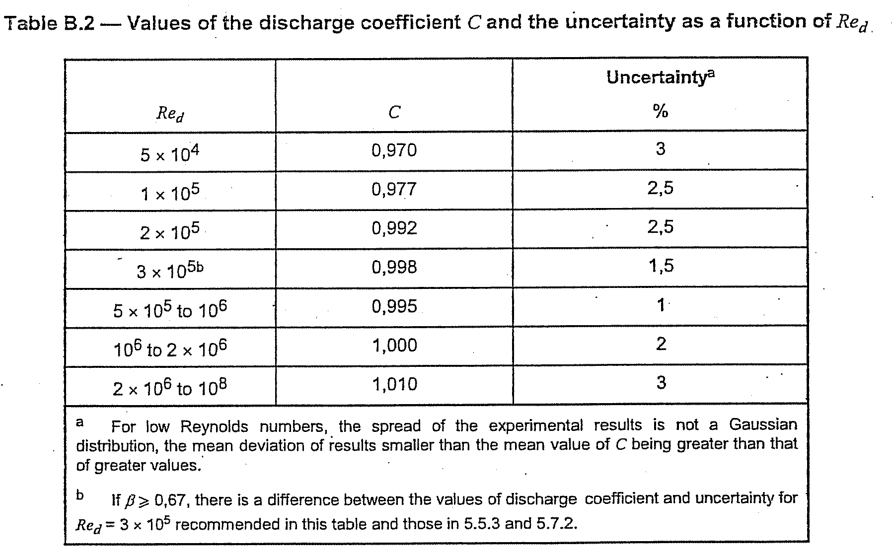
5×10⁴≦ Re_{d} ＜ 3×10⁵
C = -3×10⁻¹³ Re_{d}²＋2×10⁻⁷ Re_{d}＋0.9591
3×10⁵≦ Re_{d} ＜ 5×10⁵
C = -2×10⁻⁸ Re_{d}＋1.0025
5×10⁵≦ Re_{d} ＜ 1×10⁶
C = 0.995
1×10⁶≦ Re_{d} ＜ 2×10⁶
C = 1.000
2×10⁶≦ Re_{d} ＜ 1×10⁸
C = 1.010

Slide 18
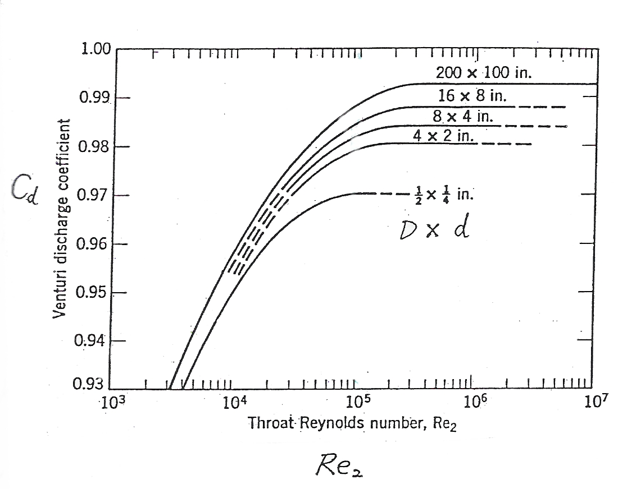
For comparison: Herschel-type Venturi Tube (USA)

Slide 19
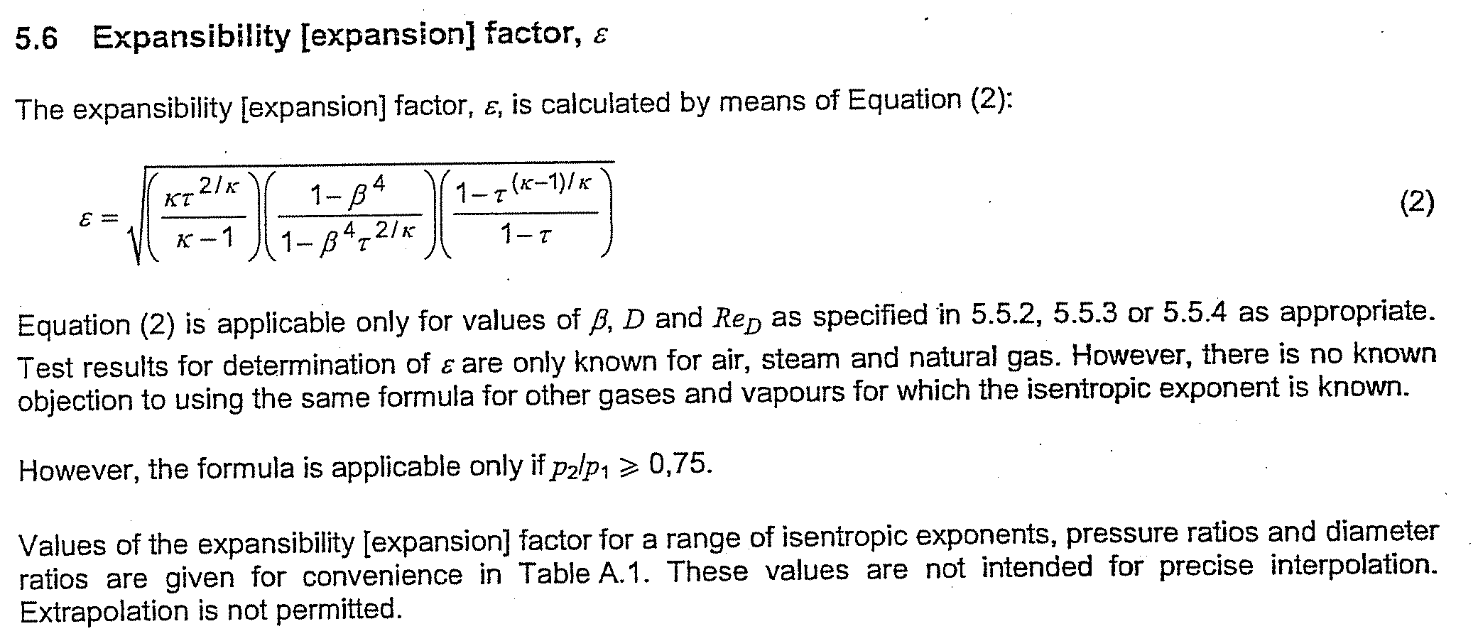
Expansibility (Expansion) Factor, ε
τ = p₂/p₁
κ = 1.4 for air

Slide 20
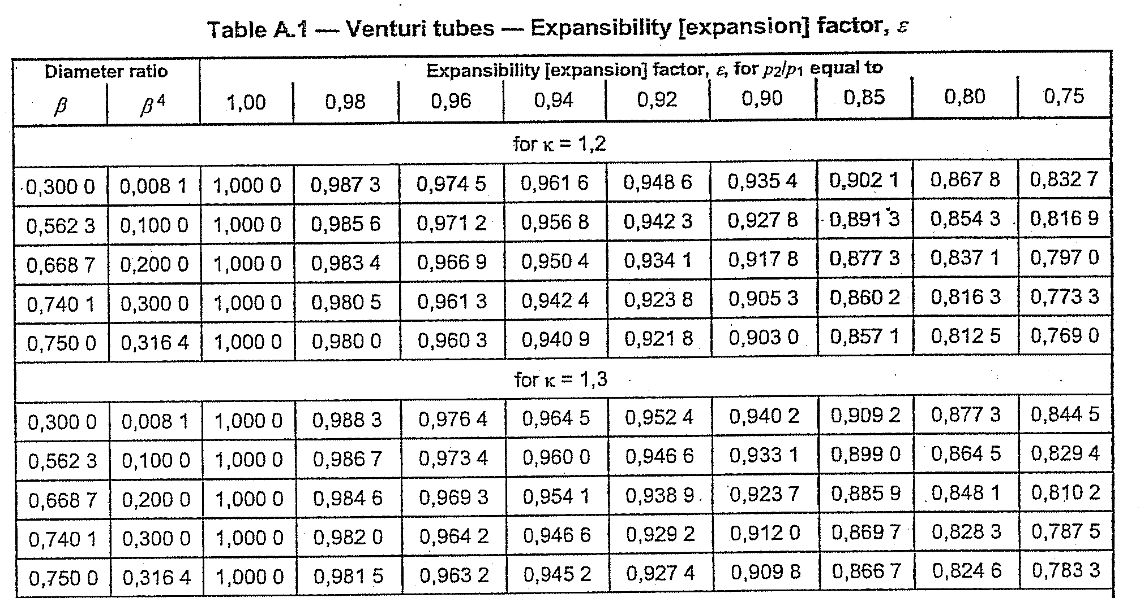

Slide 21
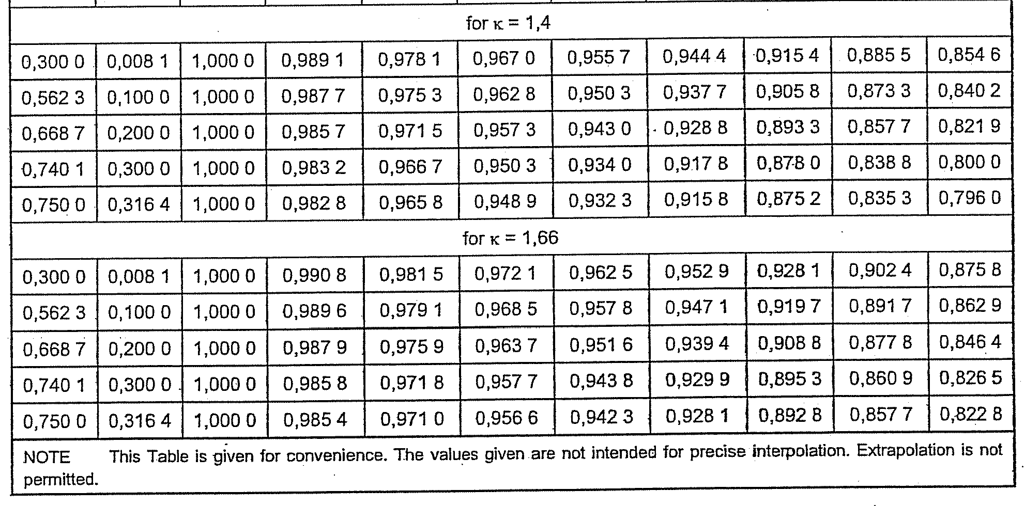

Slide 22
3. 使用Venturi Tube量測 Flow Rate之流程

Slide 23
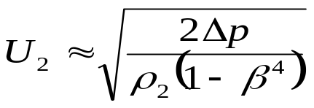
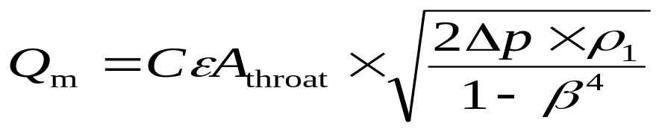
Method 1：ISO 5167-4
Measure Δp , p₁ , p₂
ρ₁ = p₁/RT₁
ρ₂ = p₂/RT₂
Calculate p₂/p₁ , ρ₁ , ρ₂, ε
ε : from Eq. (2) (p. 19)
Calculate Re_{d} by assuming
Calculate C
C : from Table B.2 (p. 17)
Calculate
β = d/D
Calculate
Q_{V1} = Q_{m} / ρ₁ ; Q_{V2} = Q_{m} / ρ₂
U₁ = Q_{V1} × A₁ ; U₂ = Q_{V2} × A₂
Re_{d} *= U₂ × d / ν₂
Let
Re_{d} = Re_{d}*
No
Re_{d} * ≈ Re_{d} ???
(may need relaxation)
Yes
ρ : Fluid density at the
temperature and pressure
for which the volume is
stated
Calculate
Q_{V} = Q_{m} / ρ
(e.g., ρ = 1.1839 kg/m³ at Ρ = 1 atm, T = 25ºC)

Slide 24
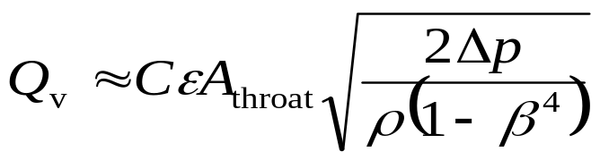
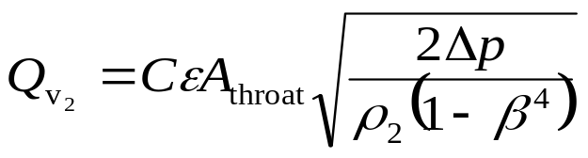
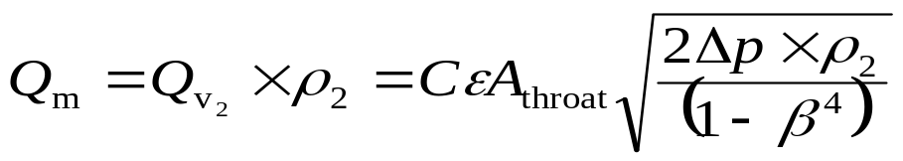
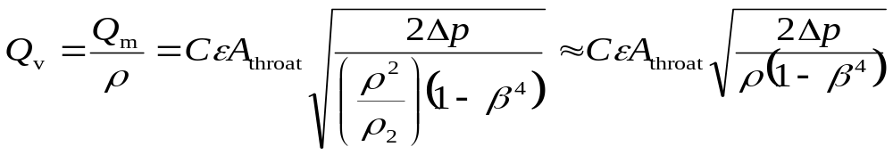
Method 2：Simplified Method
Measure Δp
C ε ≈ 0.98 –0.99 for Re_{d} > 10⁵
ρ : Fluid density at the
temperature and pressure
for which the volume is
stated.
(e.g., ρ = 1.1839 kg/m³
at p = 1 atm, T = 25ºC)
Reasoning:
Calculate Q_{V}
for the state p and T ( ρ = p /RT )

Slide 25
4. Examples

Slide 26
Ex. 1:
Method 1：ISO 5167-4
ρ₁ = p₁/RT₁
Measure Δp = 272 Pa,
p₁ = -520 Pa, p₂ = -792 Pa
ρ₂ = p₂/RT₂
d = 0.14 m
D = 0.2 m
ε : from Eq. (2) (p. 19)
p₂/p₁ = 0.9973, ρ₁ =1.161 kg/m³,
ρ₂ = 1.157 kg/m³, ε = 0.998, β = 0.7
β = 0.7
A₁ = 0.031 m²
A_{throat} = 0.015 m²
Calculate Re_{d} = 2.03×10⁵
C : from Table B.2 (p. 17)
Calculate C = 0.985
New C = 0.987
Calculate Q_{m} = 0.436 kg/s
New Q_{m} = 0.437 kg/s
Q_{V1} = 0.376 m³/s, U₁ = 11.961 m/s
Q_{V2} = 0.377 m³/s, U₂ = 24.477 m/s
Re_{d} * = 2.01 × 10⁵
Calculate
New Re_{d} * = 2.01×10⁵
New Re_{d} = 2.01×10⁵
Let
Re_{d} = Re_{d}*
No
Re_{d} * ≈ Re_{d} ???
(may need relaxation)
Yes
ρ : Fluid density at the
temperature and pressure
for which the volume is stated
Calculate
Q_{V} = Q_{m}/ ρ = 0.374 m³/s
Take ρ = 1.1692 kg/m³
at p = 76.14 cmHg, T = 27.6ºC

Slide 27
Method 2：Simplified Method
C ε ≈ 0.98 – 0.99 for Re_{d} > 10⁵
Measure Δp
ρ : Fluid density at the
temperature and pressure
for which the volume is
stated.
(e.g., ρ = 1.1839 kg/m³
at p = 1 atm, T = 25ºC)
Take
d = 0.14 m
D = 0.2 m
C ε ≈ 0.99
Measure Δp = 272 Pa
ρ = 1.1692 kg/m³
at p = 76.14 cmHg, T = 27.6ºC
β = 0.7
A₁ = 0.031 m²
A_{throat} = 0.015 m²
Q_{v} = 0.377 m³/s

